Slide 1
Unit 3
OLAP Technology for Data Mining

Slide 2
Concept Hierarchy
Sequence of mappings from a set of low-level concepts to higher-level, more general concepts.
Consider a concept hierarchy for the dimension location.
City values for location include Vancouver, Toronto, New York, and Chicago.
Each city, however, can be mapped to the province or state to which it belongs.
For example, Vancouver can be mapped to British Columbia, and Chicago to Illinois.
The provinces and states can in turn be mapped to the country (e.g., Canada or the United States) to which they belong.
These mappings form a concept hierarchy for the dimension location, mapping a set of low-level concepts (i.e., cities) to higher-level, more general concepts (i.e., countries)

Slide 3
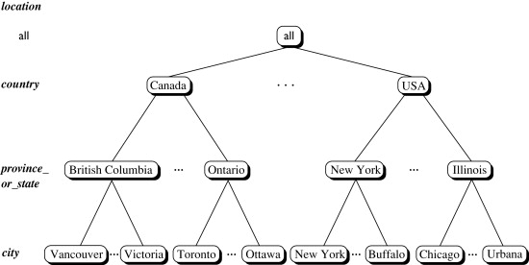

Slide 4
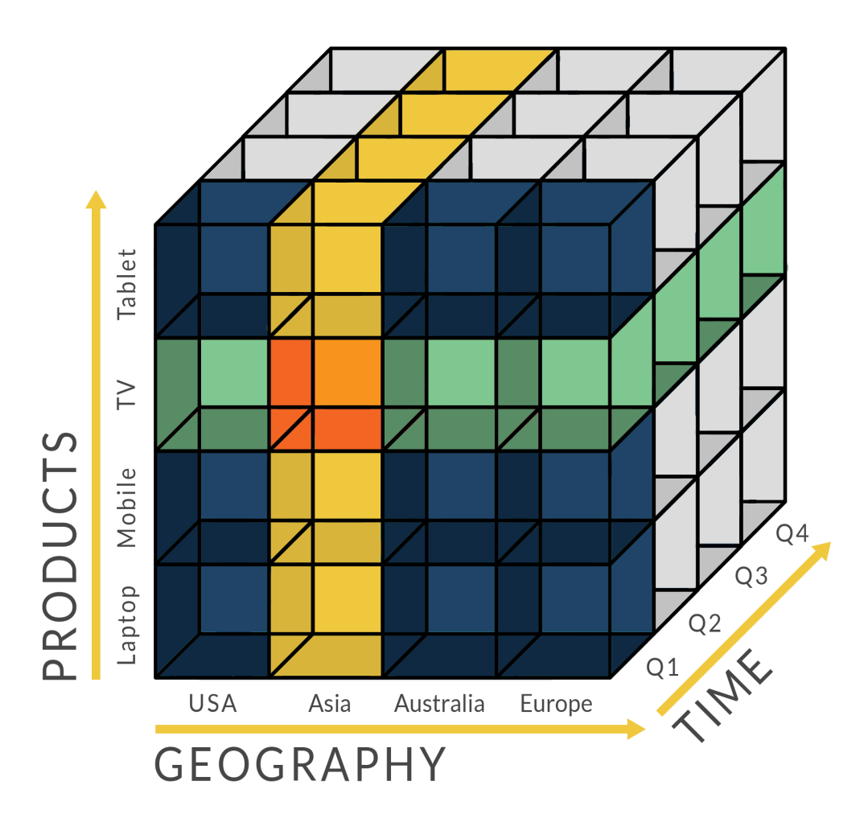
OLAP
Online Analytical Processing
● OLAP performs multidimensional analysis of business data and provides the capability for complex calculations, trend analysis, and sophisticated data modeling.
●It is the foundation for many kinds of business applications for Business Performance Management, Planning, Budgeting, Forecasting, Financial Reporting, Analysis, Simulation Models, Knowledge Discovery, and Data Warehouse Reporting.
● OLAP enables end-users to perform analysis of data in multiple dimensions, thereby providing the insight and understanding they need for better decision making.

Slide 5
OLAP Operations in the Multidimensional Data Model
Roll-up (drill-up)
• Drill-down (roll-down)
• Slice
• Dice
• Pivot (rotate)

Slide 6
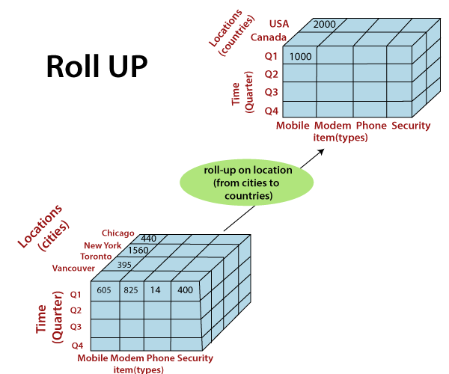
Roll-up (drill-up)
Performs aggregation on a data cube, by climbing down concept hierarchies, i.e., dimension reduction
Zooming-out on the data cubes.
One or more dimensions are removed from the cube.

Slide 7
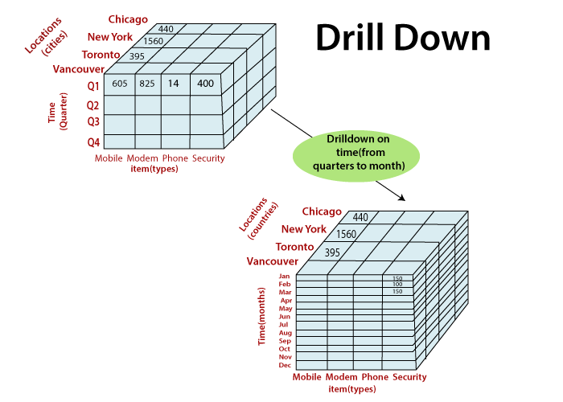
Drill-Down
Reverse operation of roll-up
Zooming-in on the data cube
Navigates from less detailed record to more detailed data
Performed by either stepping down a concept hierarchy for a dimension or adding additional dimensions.
Drill-down adds more details to the given data

Slide 8
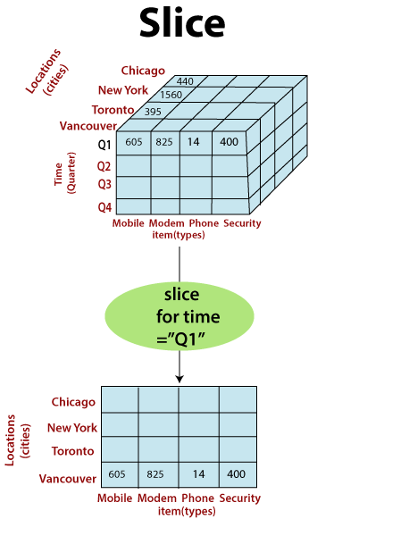
Slice
A slice is a subset of the cubes corresponding to a single value for one or more members of the dimension.
For example, a slice operation is executed when the customer wants a selection on one dimension of a three-dimensional cube resulting in a two-dimensional site.
The Slice operations perform a selection on one dimension of the given cube, thus resulting in a sub-cube.
Slice is functioning for the dimensions "time" using the criterion time = "Q1".

Slide 9
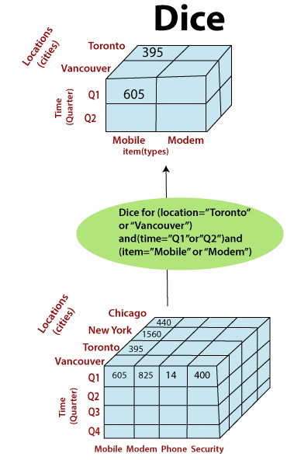
Dice
The dice operation describes a sub-cube by operating a selection on two or more dimension.
The dice operation on the cubes based on the following selection criteria involves three dimensions.
(location = "Toronto" or "Vancouver")
(time = "Q1" or "Q2")
(item =" Mobile" or "Modem")

Slide 10
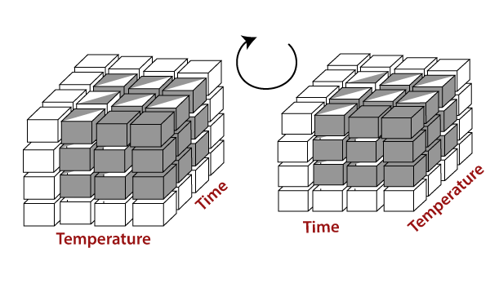
Pivot
The pivot operation is also called a rotation.
Pivot is a visualization operations which rotates the data axes in view to provide an alternative presentation of the data.

Slide 11
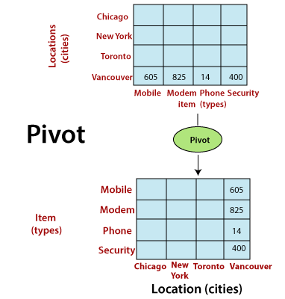
Pivot may contain swapping the rows and columns or moving one of the row-dimensions into the column dimensions.

Slide 12
OLAP Operations → Other Operations
Drill-across executes queries involving (i.e., across) more than one fact table.
The drill-through operation uses relational SQL facilities to drill through the bottom level of a data cube down to its back-end relational tables.
Other OLAP operations may include ranking the top N or bottom N items in lists, as well as computing moving averages, growth rates, interests, internal return rates, depreciation, currency conversions, and statistical functions.

Slide 13
OLAP server
OLAP server is what does all the work and where the actively accessed data is stored.
Operate the processed multidimensional information to provide users with consistent and fast response.
The server can also populate its data structures in real time from different databases.
Functions of OLAP server
Data transformation
Storage
Analysis
Data presentation and access

Slide 14
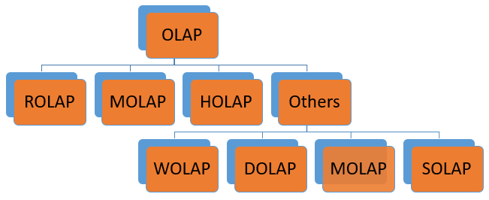
OLAP Server Architectures
Logically, OLAP servers present business users with multidimensional data from data warehouses or data marts, without concerns regarding how or where the data are stored.
However, the physical architecture and implementation of OLAP servers must consider data storage issues.
Implementations of a warehouse server for OLAP processing include the following
- ROLAP
- MOLAP
- HOLAP
OLAP Hierarchical Structure

Slide 15
OLAP Server Architectures: ROLAP
Relational OLAP
Fact and dimension tables are stored in relations
These are intermediate servers which stand in between a relational back-end server and user frontend tools.
They use a relational or extended-relational DBMS to save and handle warehouse data, and OLAP middleware to provide missing pieces.
ROLAP technology tends to have higher scalability than MOLAP technology.
ROLAP systems work primarily from the data that resides in a relational database, where the base data and dimension tables are stored as relational tables. This model permits the multidimensional analysis of data.

Slide 16
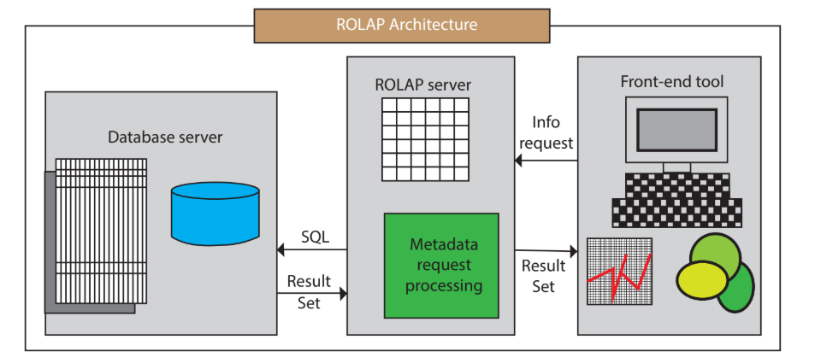
ROLAP Architecture includes the following components
Database server.
ROLAP server.
Front-end tool.

Slide 17
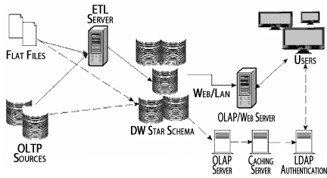
Relational On-Line Analytical Processing (ROLAP) performs dynamic multidimensional analysis of data stored in a relational database, rather than in a multidimensional database.
The traditional OLAP's slice and dice functionality is equivalent to adding a WHERE clause in the SQL statement.
The design may be structured in the form of a star or its variations.
A typical use of ROLAP is for large data size that is infrequently queried, such as historical data.

Slide 18
OLAP Server Architectures: ROLAP
Advantages
Can handle large amounts of information: The data size limitation of ROLAP technology is depends on the data size of the underlying RDBMS. So, ROLAP itself does not restrict the data amount.
RDBMS already comes with a lot of features. So ROLAP technologies, (works on top of the RDBMS) can control these functionalities.
Disadvantages
Performance can be slow: Each ROLAP report is a SQL query (or multiple SQL queries) in the relational database, the query time can be prolonged if the underlying data size is large.
Limited by SQL functionalities: ROLAP technology relies on upon developing SQL statements to query the relational database, and SQL statements do not suit all needs.

Slide 19
OLAP Server Architectures: MOLAP
Multidimensional OLAP
A MOLAP system is based on a native logical model that directly supports multidimensional data and operations.
Data are stored physically into multidimensional arrays, and positional techniques are used to access them.
One of the significant distinctions of MOLAP against a ROLAP is that data are summarized and are stored in an optimized format in a multidimensional cube, instead of in a relational database.
Oracle Essbase and Microsoft SQL Server Analysis Services are among the most prominent.

Slide 20
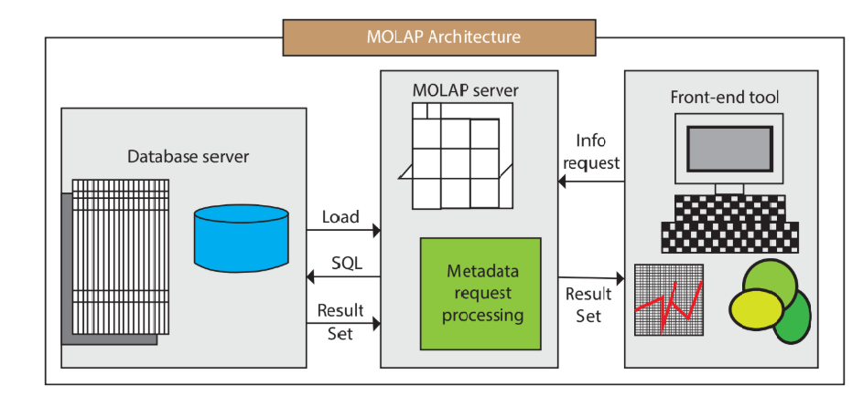
MOLAP Architecture includes the following components
Database server.
MOLAP server.
Front-end tool.
MOLAP structure primarily reads the precompiled data.
MOLAP structure has limited capabilities to dynamically create aggregations or to evaluate results which have not been pre-calculated and stored.
Applications requiring iterative and comprehensive time-series analysis of trends are well suited for MOLAP technology (e.g., financial analysis and budgeting).

Slide 21
OLAP Server Architectures: MOLAP(pros and cons)
Advantages
Excellent Performance: A MOLAP cube is built for fast information retrieval, and is optimal for slicing and dicing operations.
Can perform complex calculations: All evaluation have been pre-generated when the cube is created. Hence, complex calculations are not only possible, but they return quickly.
Disadvantages
Limited in the amount of information it can handle: Because all calculations are performed when the cube is built, it is not possible to contain a large amount of data in the cube itself.
Requires additional investment: Cube technology is generally proprietary and does not already exist in the organization. Therefore, to adopt MOLAP technology, chances are other investments in human and capital resources are needed.

Slide 22
Implementation Considerations in MOLAP
In MOLAP it’s essential to consider both maintenance and storage implications to creating strategy for building cubes.
Proprietary languages used to query MOLAP.
Difficult to scale because the number and size of cubes required when dimensions increase.
API’s should provide for probing the cubes.
Data structure to support multiple subject areas of data analyses which data can be navigated and analyzed. When the navigation changes, the data structure needs to be physically reorganized.
Need different skill set and tools for Database administrator to build, maintain the database.

Slide 23
MOLAP Tools
Essbase– Tools from Oracle that has a multidimensional database.
Express Server– Web-based environment that runs on Oracle database.
Yellowfin– Business analytics tools for creating reports and dashboards.
Clear Analytics– Clear analytics is an Excel-based business solution.
SAP Business Intelligence – Business analytics solutions from SAP

Slide 24
OLAP Server Architectures: HOLAP
Hybrid OLAP
HOLAP incorporates the best features of MOLAP and ROLAP into a single architecture.
HOLAP systems save more substantial quantities of detailed data in the relational tables while the aggregations are stored in the pre-calculated cubes.
HOLAP also can drill through from the cube down to the relational tables for delineated data.
The Microsoft SQL Server 2000 provides a hybrid OLAP server

Slide 25
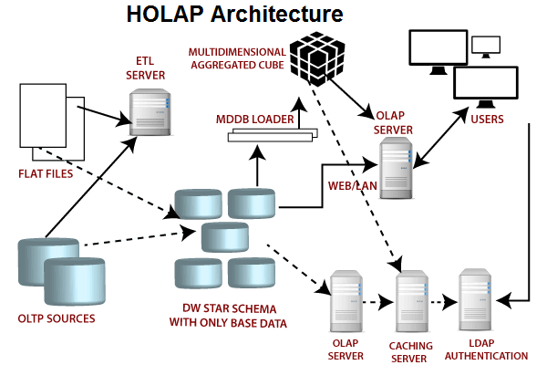

Slide 26
OLAP Server Architectures: HOLAP(pros and cons)
Advantages of HOLAP
HOLAP provide benefits of both MOLAP and ROLAP.
It provides fast access at all levels of aggregation.
HOLAP balances the disk space requirement, as it only stores the aggregate information on the OLAP server and the detail record remains in the relational database.
No duplicate copy of the detail record is maintained.
Disadvantages of HOLAP
HOLAP architecture is very complicated because it supports both MOLAP and ROLAP servers.

Slide 27
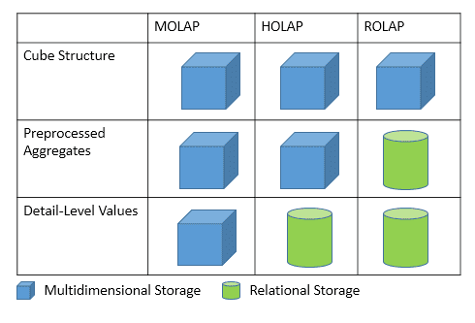
OLAP Server Architectures: ROLAP Vs MOLAP Vs HOLAP

Slide 28
OLAP Server Architectures: Other Types
Web-Enabled OLAP (WOLAP) Server
WOLAP pertains to OLAP application which is accessible via the web browser. Unlike
traditional client/server OLAP applications, WOLAP is considered to have a three tiered
architecture which consists of three components: a client, a middleware, and a database server.
Desktop OLAP (DOLAP) Server
DOLAP permits a user to download a section of the data from the database or source,
and work with that dataset locally, or on their desktop.
Mobile OLAP (MOLAP) Server
Mobile OLAP enables users to access and work on OLAP data and applications remotely
through the use of their mobile devices.
Spatial OLAP (SOLAP) Server
SOLAP includes the capabilities of both Geographic Information Systems (GIS) and
OLAP into a single user interface. It facilitates the management of both spatial and
non-spatial data.

Slide 29
OLTP(Online Transaction Processing)
OLTP is an operational system that supports
transaction-oriented applications in a 3-tier architecture(presentation tier, a business logic
tier, and a data store tier).
It administers the day to day transaction of an
organization.
OLTP is basically focused on query processing,
maintaining data integrity in multi-access
environments as well as effectiveness that is
measured by the total number of transactions per
second.

Slide 30
OLTP → Characteristics
● OLTP uses transactions that include small amounts of data.
● Indexed data in the database can be accessed easily.
● OLTP has a large number of users.
● It has fast response times.
● It strictly performs only the predefined operations on a small number of records.
● OLTP stores the records of the last few days or a week.
● It supports complex data models and tables

